Slide 1
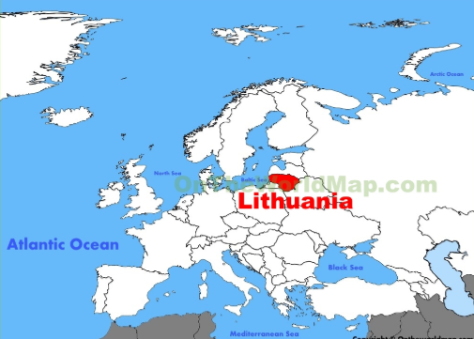
Hello! – Sveiki!

Slide 2
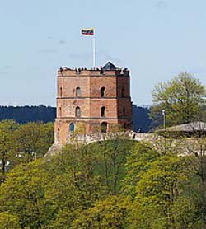
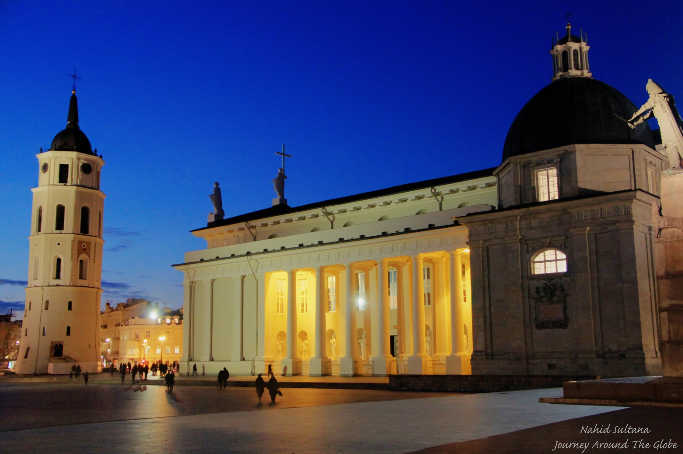
The capital city- Vilnius

Slide 3
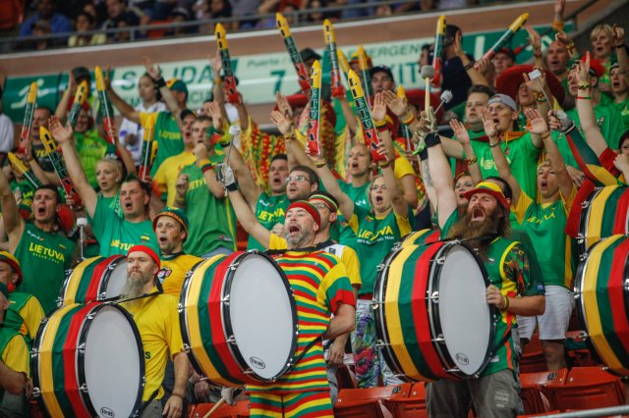
We love basketball!

Slide 4
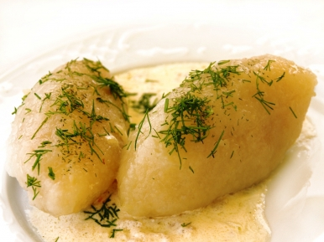
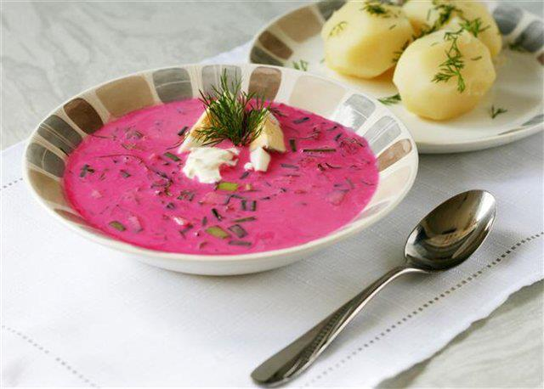
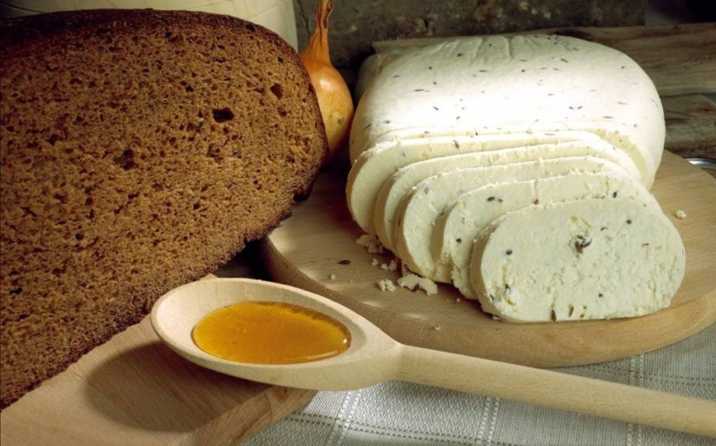

Slide 5
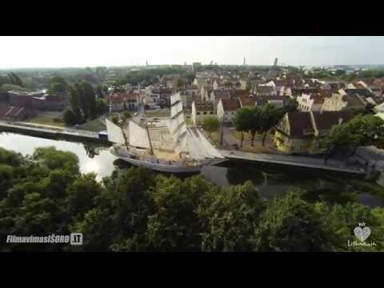
Little, but very beautiful country

Slide 6
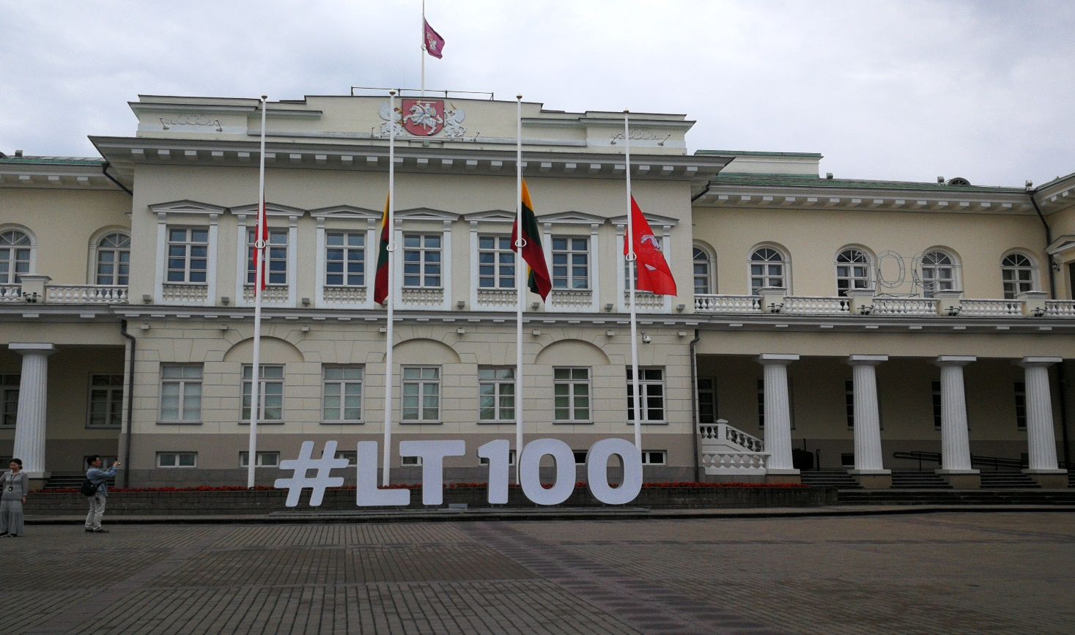
We celebrate the Centennial of the restored Lithuania

Slide 7
Educational system in Lithuania
Educational institucions are state, municipality or private;
Education is free of charge (except private schools);
Education is compulsary from 6 till 16 years;
The official language at schools is lithuanian.

Slide 8
There are 2 semesters or 3 terms per year.
A lessons last for 45 min., but for 1st class– 35 min.
There are 20-22 students in a class.

Slide 9
General principals
1st of September is the beginning of a school year;
The beggining of June – the end of a school year for the pre-primary and primary school students.
5-11 classes - the end of June
12 class – the end of May

Slide 10
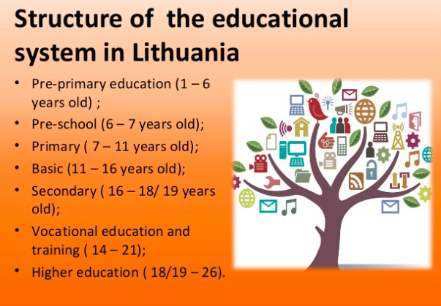

Slide 11
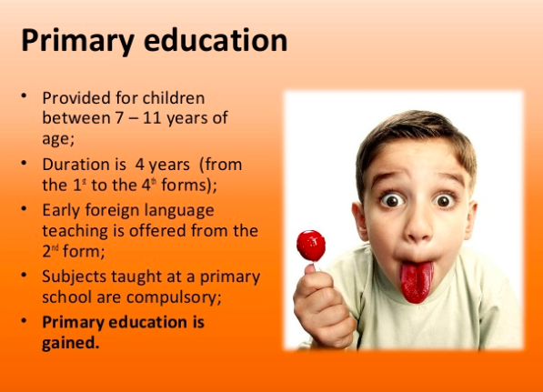

Slide 12
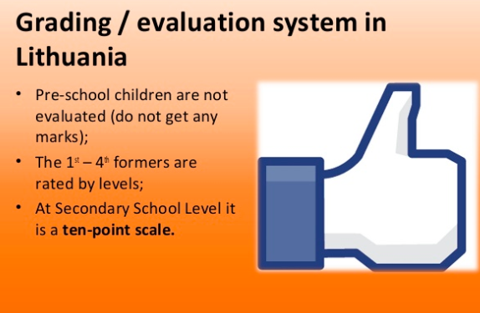

Slide 13
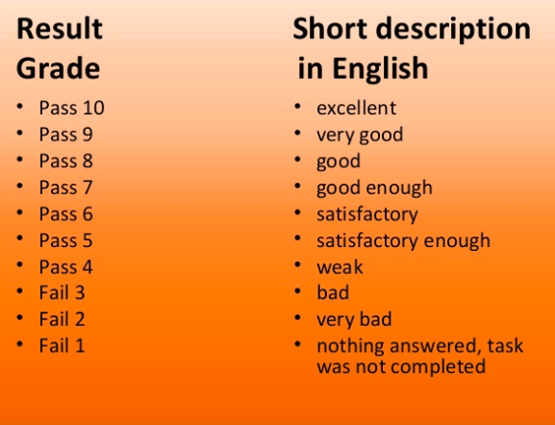

Slide 14
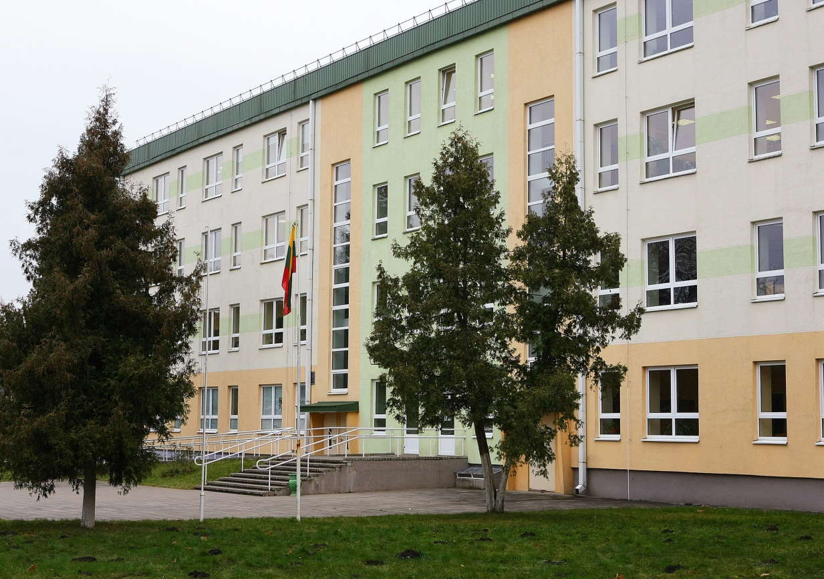
Juodšiliai gymnasium

Slide 15
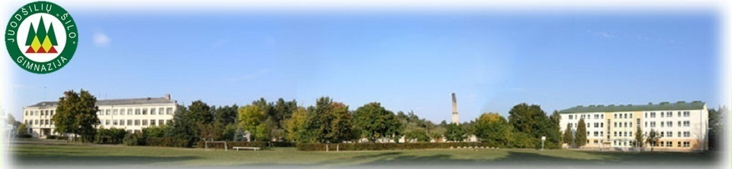
Philosophy, Vision, Mission of gymnasium
Philosophy
We learn not in the school, but in life. (Seneca)
Vision
Through our activities we are constantly learning democracy and humanism.
Mission
Implementing the policy of education, to carry out from pre-school to secondary education, to prepare independant and creative personalities responsible for the future of the country.

Slide 16
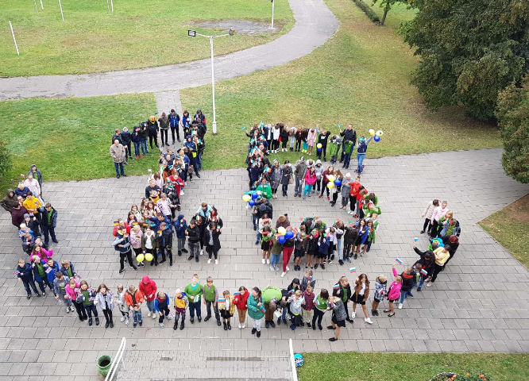
The Students
During the 2019-2020 school year there were 501 students: 5 groups in the kindergarden 2 groups of preschoolers 8 classes of primary students 7 classes of middle school students 6 classes of gymnasium students

Slide 18
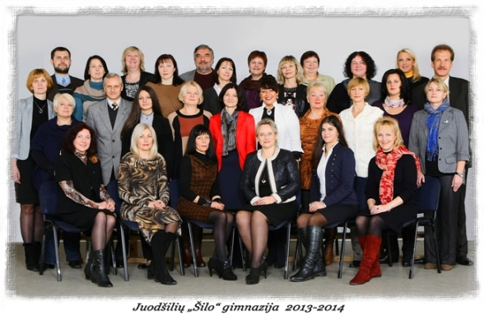
The Teachers
There are 45 teachers working in the school: 1 teacher expert 11 teachers methodologists 31 senior teachers 2 teachers The gymnasium also has a social worker, an educator of students with special needs, a nurse, 8 kindergarten teachers, 2 pre-school teacher.

Slide 19
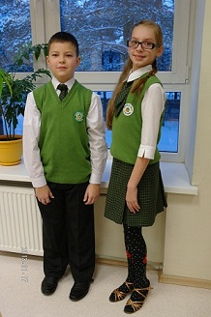
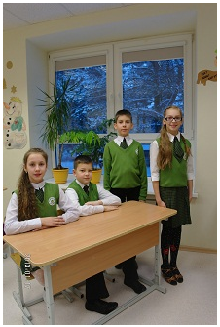
The uniform of the gymnasium

Slide 20
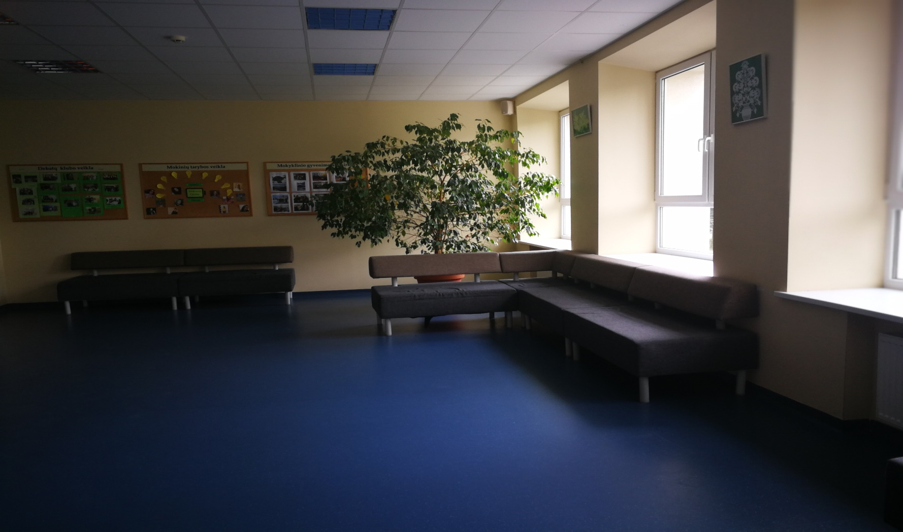
The look of gymnasium

Slide 21
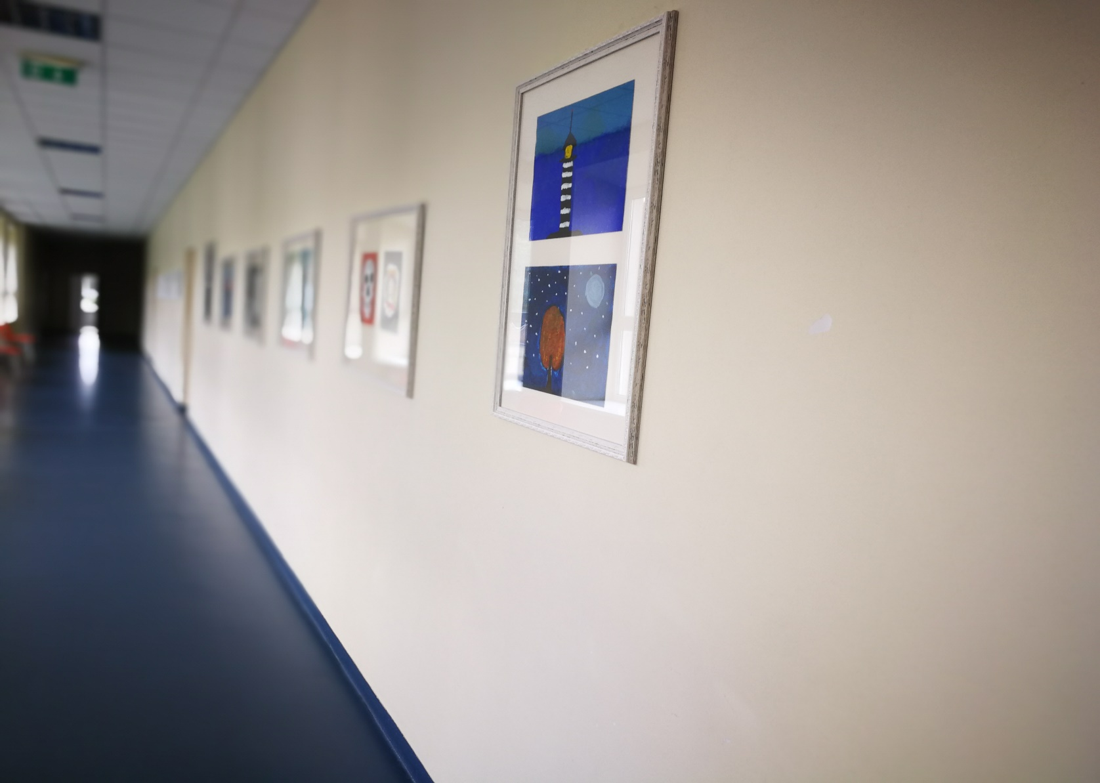

Slide 22
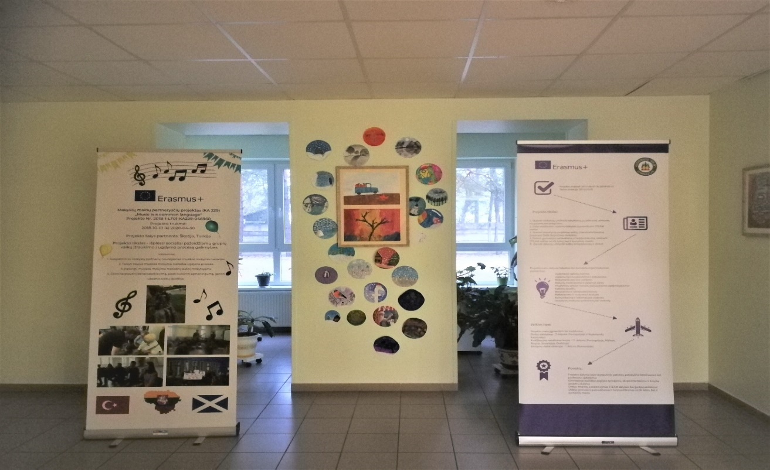

Slide 23
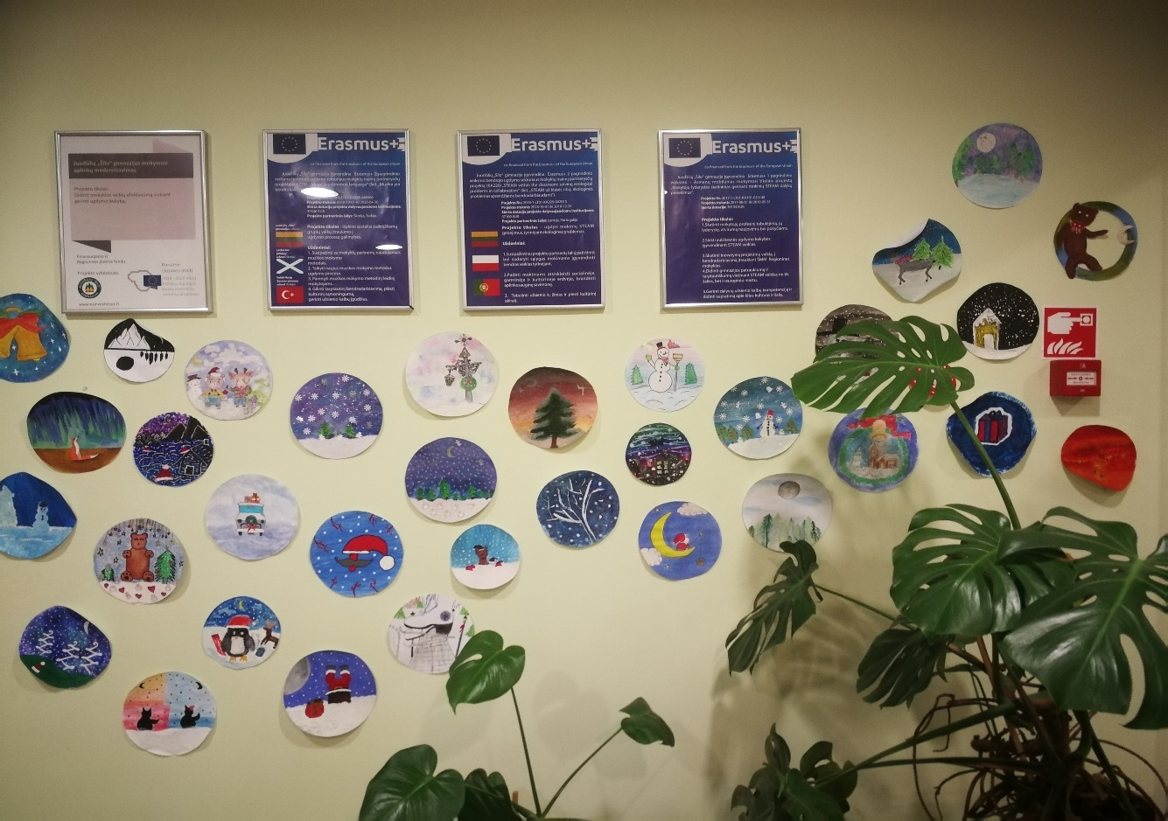

Slide 24
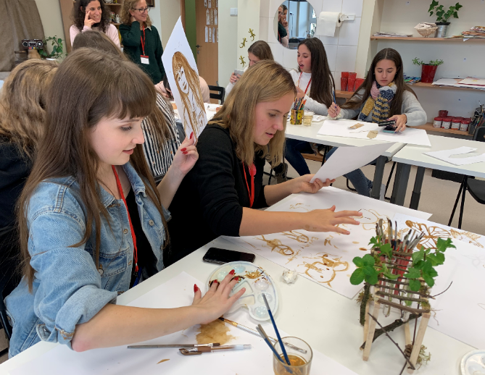

Slide 25
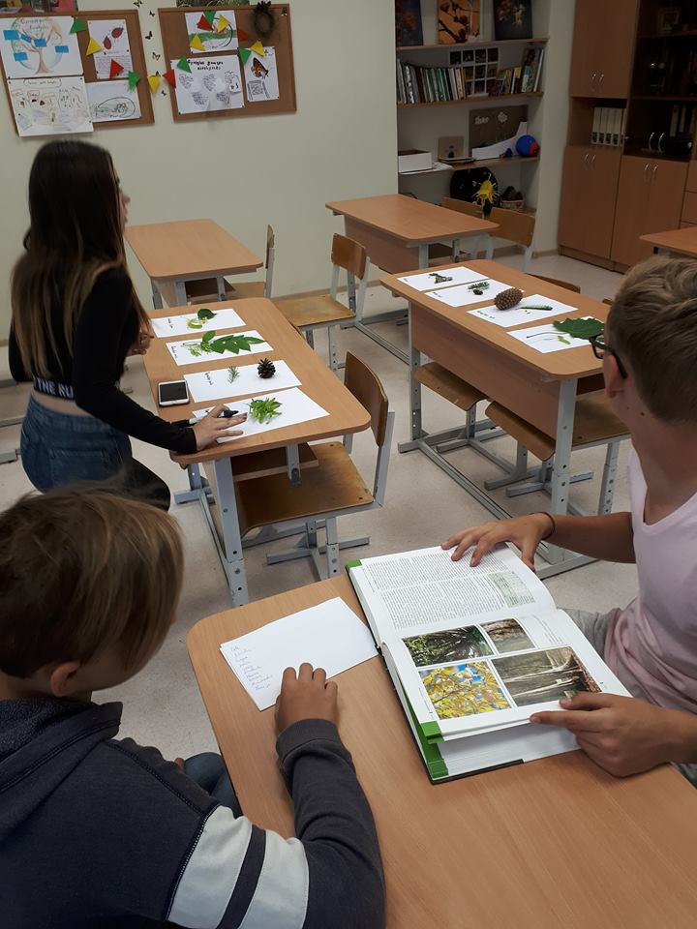

Slide 26
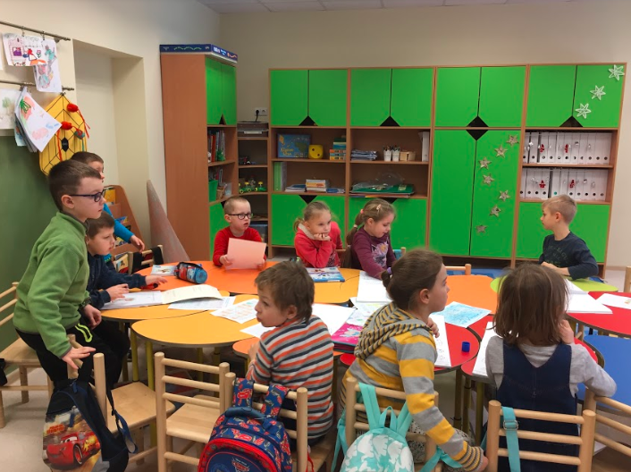

Slide 27
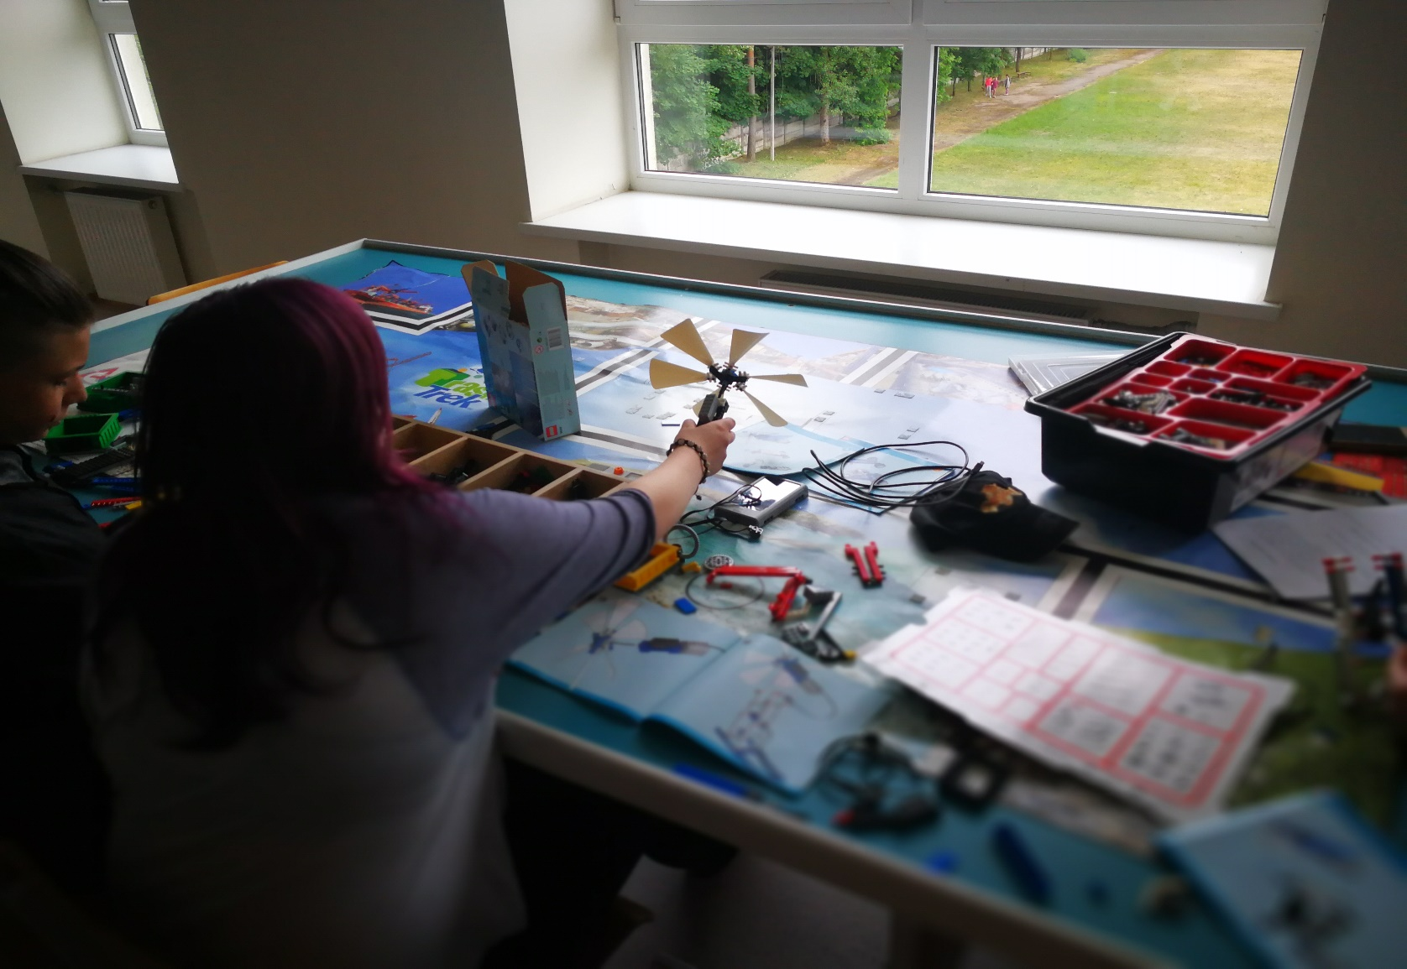

Slide 28
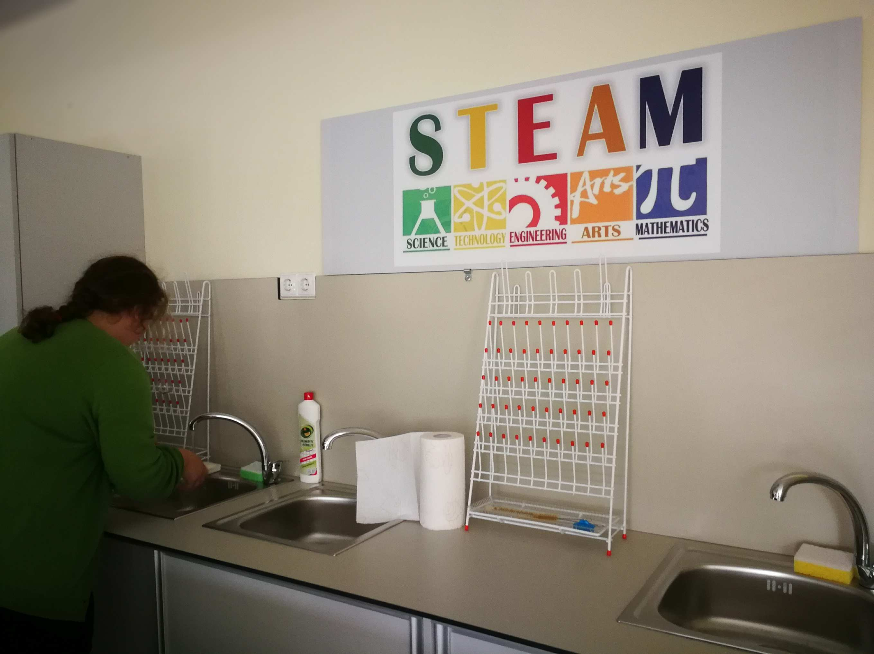

Slide 29
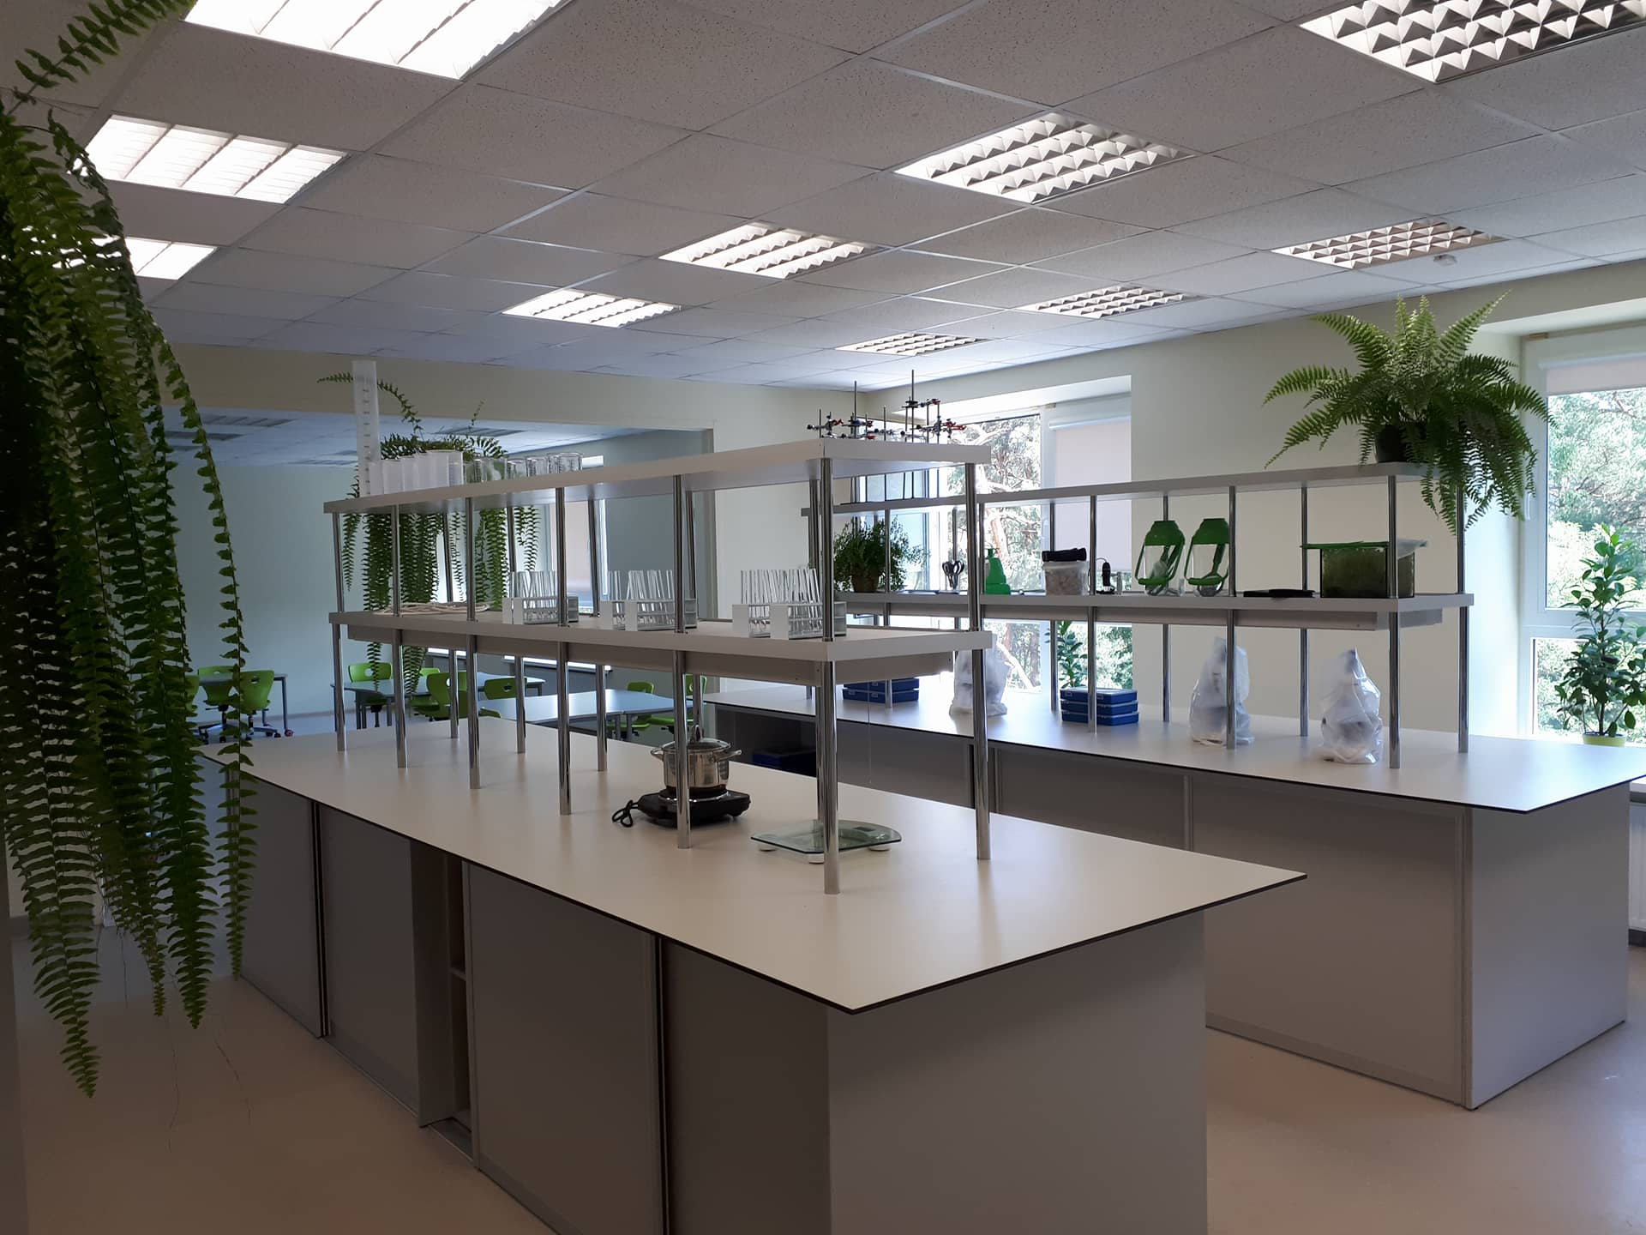

Slide 30
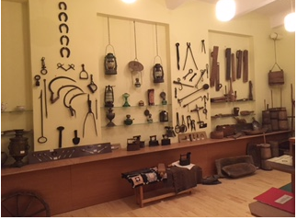
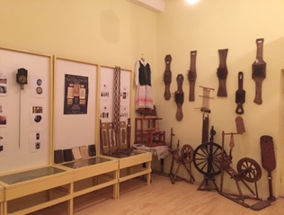
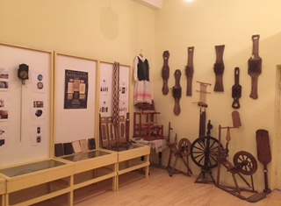
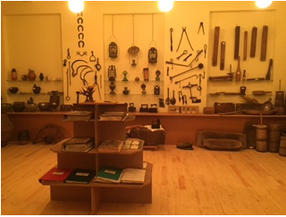

Slide 31
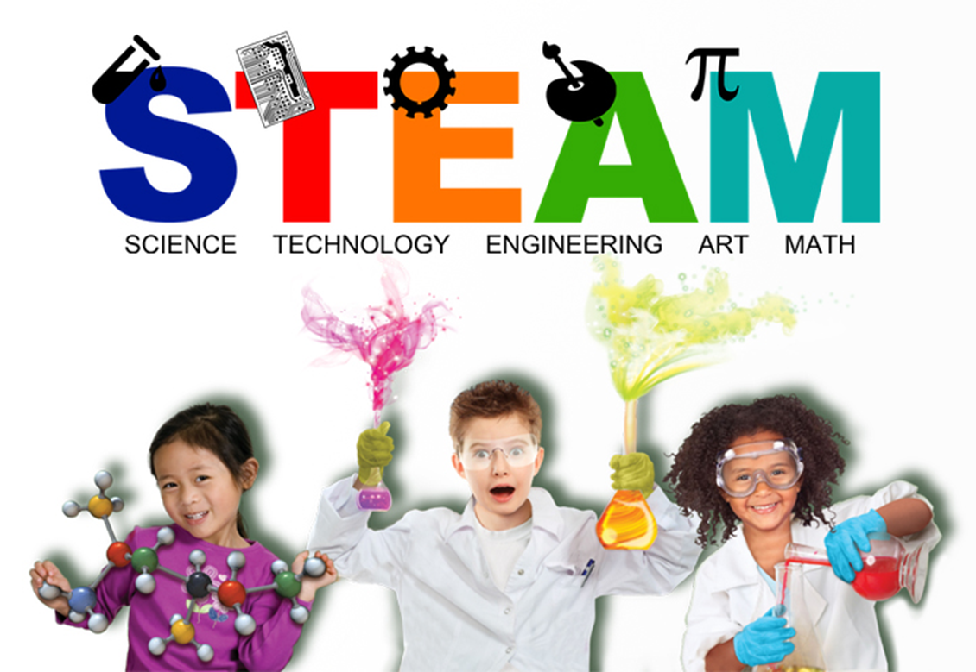
Our school

Slide 32
"We are preparing children for professions that do not yet exist, for technologies that have not yet been developed, to solve problems, that are not yet named."
Ken Robinson

Slide 33
Teacher Skills Improvement and Retraining System conducted by the Center for Development Education, and we were selected among the 14 best schools that seek to strengthen the education of nature and the sciences, we became STEAM school, therefore We constantly strive to strengthen students' critical thinking, research competences, develop communicative skills and creativity. The Steam Schools Network has developed long-term strategies for developing Steam's skills and gymnasium documents for progress in the Steam School.

Slide 34
STEAM in formal education
Big attention to students practical activities

Slide 35
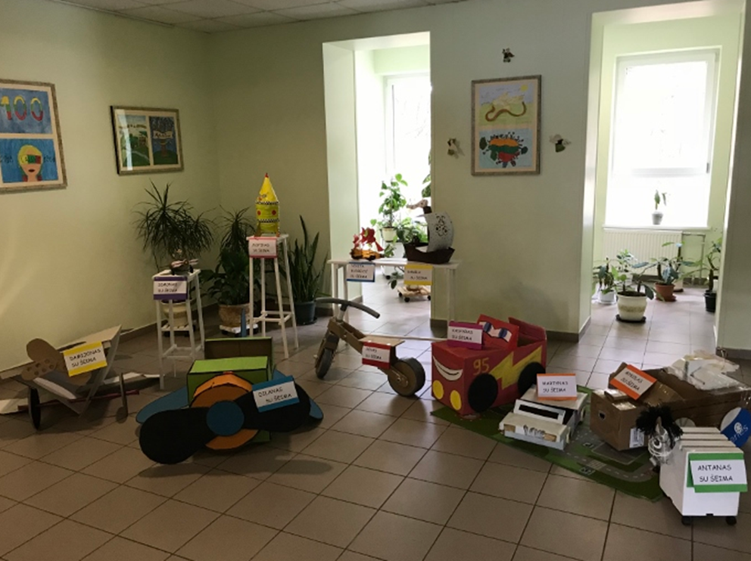

Slide 36
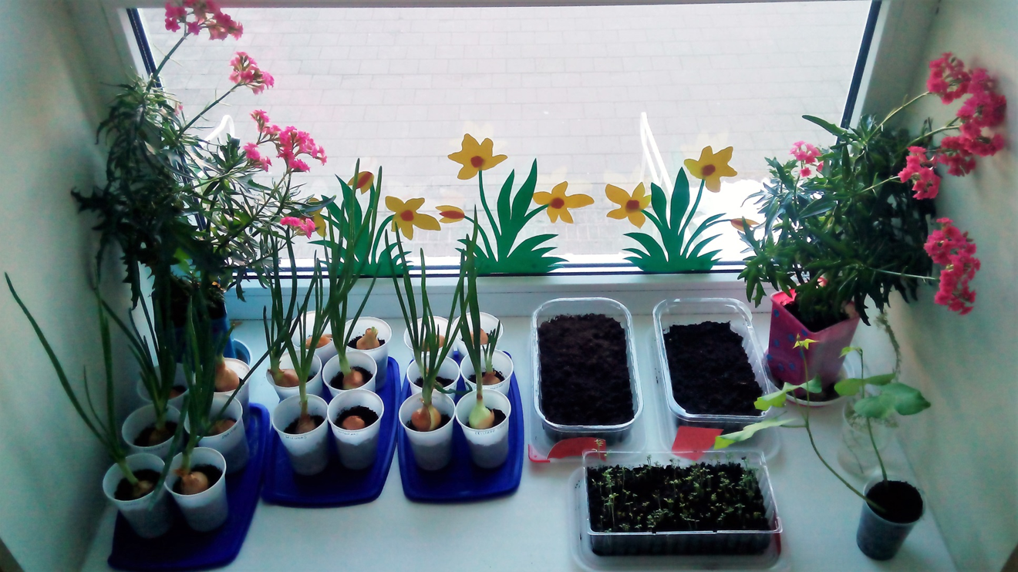

Slide 37
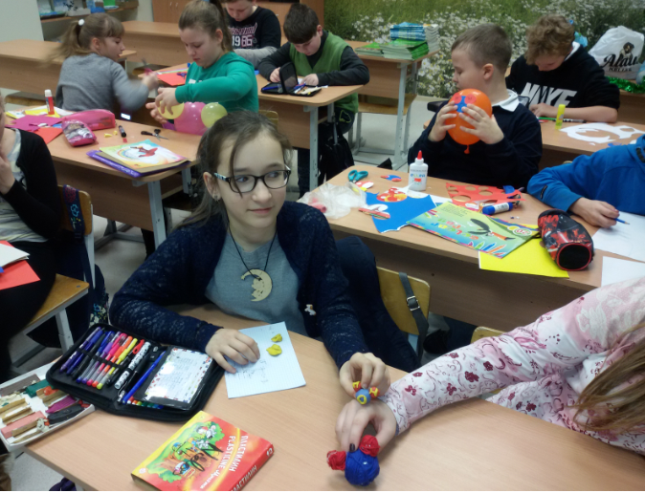

Slide 38
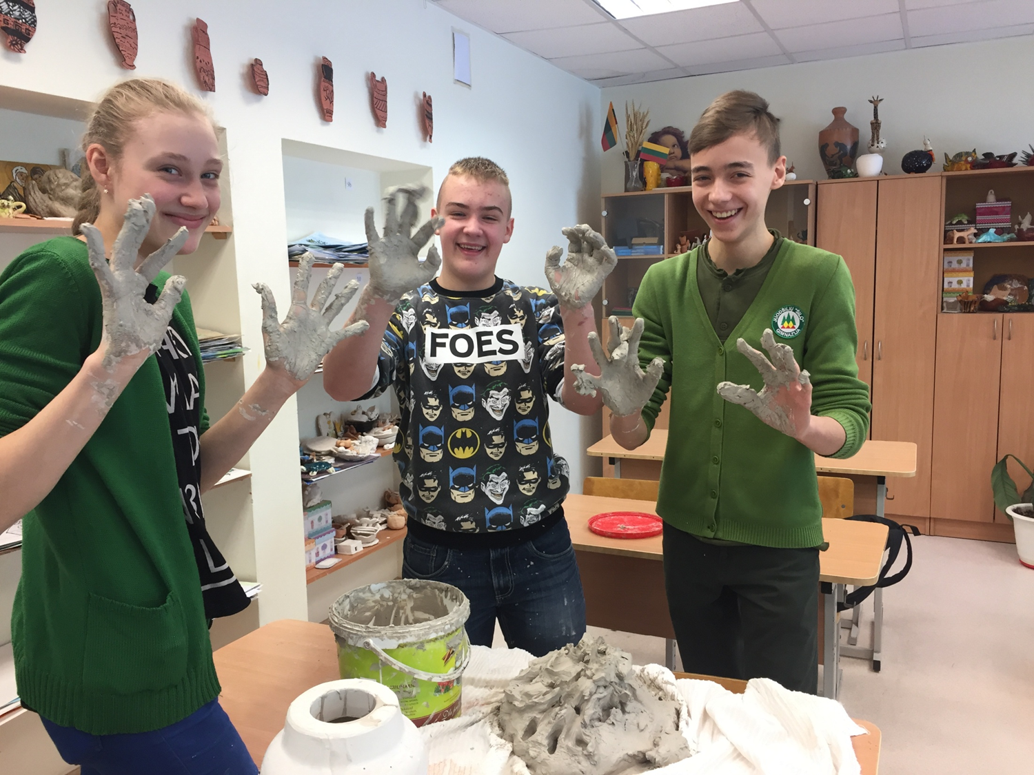

Slide 39
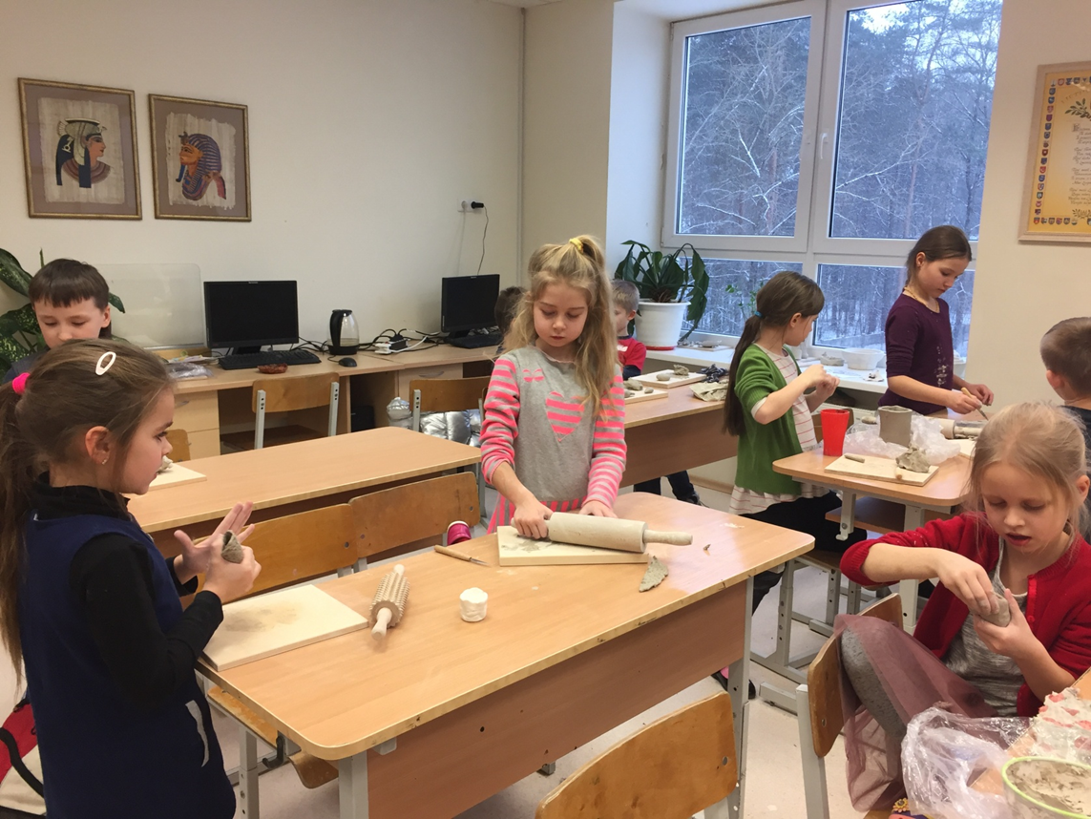

Slide 40
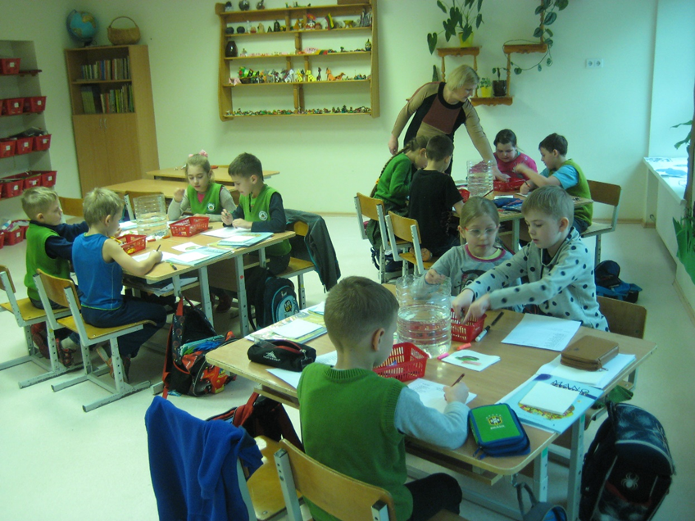

Slide 41
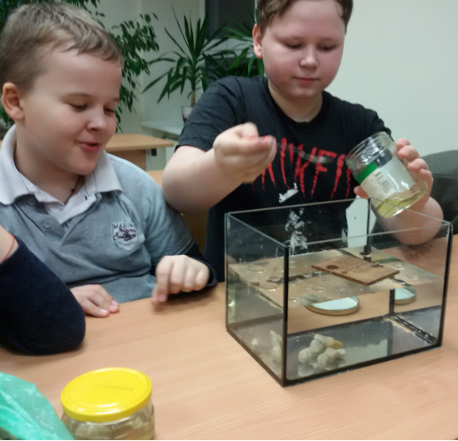
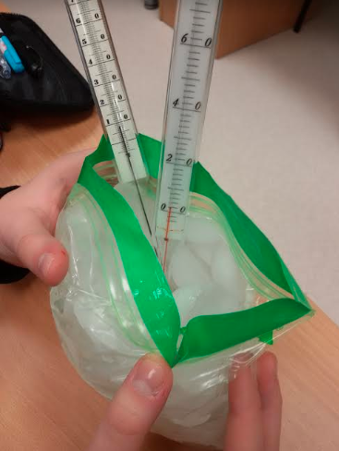

Slide 42
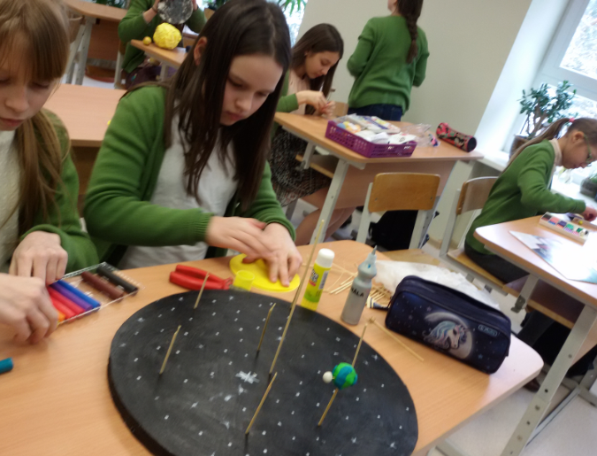

Slide 43
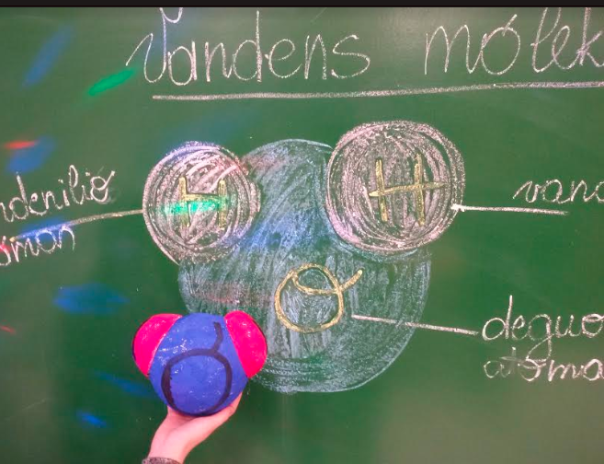

Slide 44
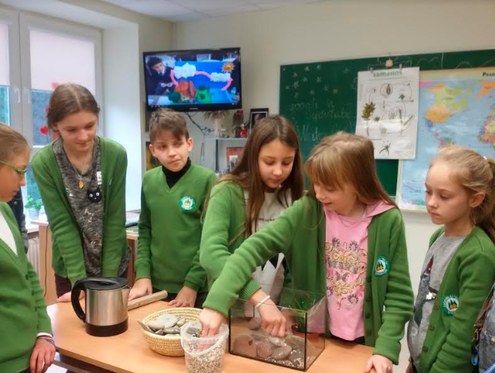

Slide 45
A grateful environment (There is a forest around our school, we have a big teritory)
Lessons not only at school class, but outside too

Slide 46
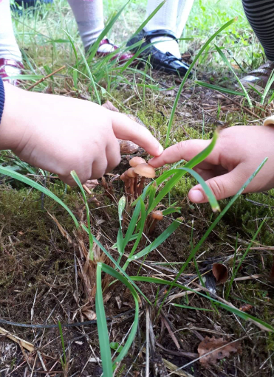
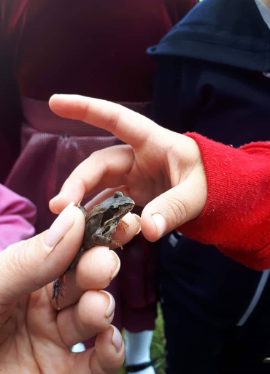

Slide 47
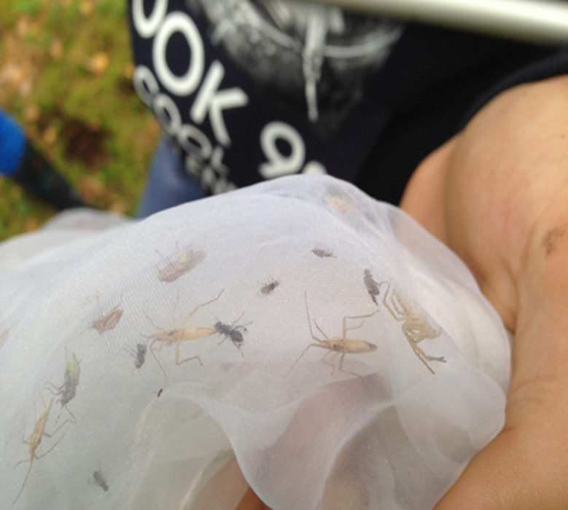
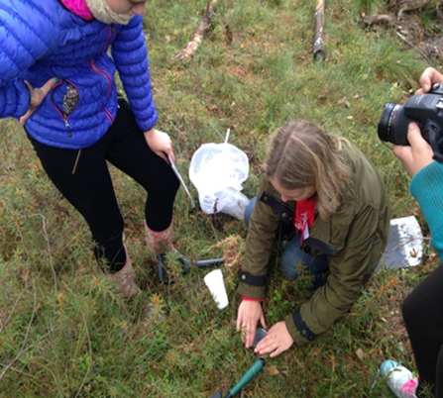

Slide 48
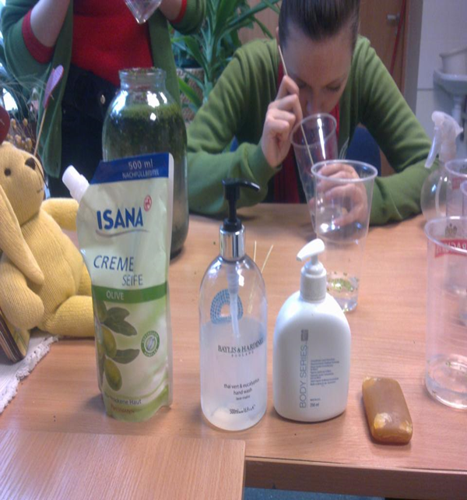


Slide 49




Slide 50


Slide 51


Slide 52


Slide 53
Modern measures

Slide 54
Laboratory

Slide 55


Slide 56


Slide 57
2018 years we won a modernization project and got 300 000 eur to modernize STEAM class. Now students can work with very inovative measures

Slide 58




Slide 59


Slide 60



Slide 61


Slide 62


Slide 63


Slide 64



„The Cool Tool“

Slide 65
We work with social partners (Vilnius university, Vilnius Gediminas Technical University and etc.)

Slide 66


Slide 67


Slide 68

Google SketchUp

Slide 69


Slide 70
Integrated science course
There are no separate subjects biology, chemistry, physics at 5-7 classes.
All these subjects are taught in an integrated way as one subject.

Slide 71

Non-formal education

Slide 72


Slide 73



Slide 74


Slide 75


Slide 76
International projects
Erasmus+
Promoting teacher leadership by improving student achievement in STEAM subjects (KA1; 2017-2019)
„STEAM within the classroom: solving ecological problems in collaboration“(KA229)

Slide 77

Results

Slide 78


Slide 79
In summary
Very important for steam training and student motivation:
Learning by Exploration from pre-primary school
Student collaboration and teamwork is encouraged.
We devote at least 30 percent of the subject-matter lessons during the school year to developing experimental and practical skills.
Natural science projects
interactive teaching/learning methods
Purposeful in-service training of teachers

Slide 80

Leadership
And, of course, all this would not be without .... TEACHERS - LEADERS, ENTHUSIASTS, CREATORS, ASSISTANTS ... so we also have always to study .... from children also ☺

Slide 81


Slide 82

You are always welcome!
mokykla@silo.vilnius.lm.lt

Slide 83
THANK YOU ! – AČIŪ !

