Slide 1

Project meeting
"TEAM in STEAM"
Strategies for Teaching, Education And learning Motivation by STEAM (Science, Technology, Engineering, Art and Maths) approach
No. 2019-1-RO01-KA201-063054
Quinta do Conde, Portugal
8-11 January 2020

Slide 2
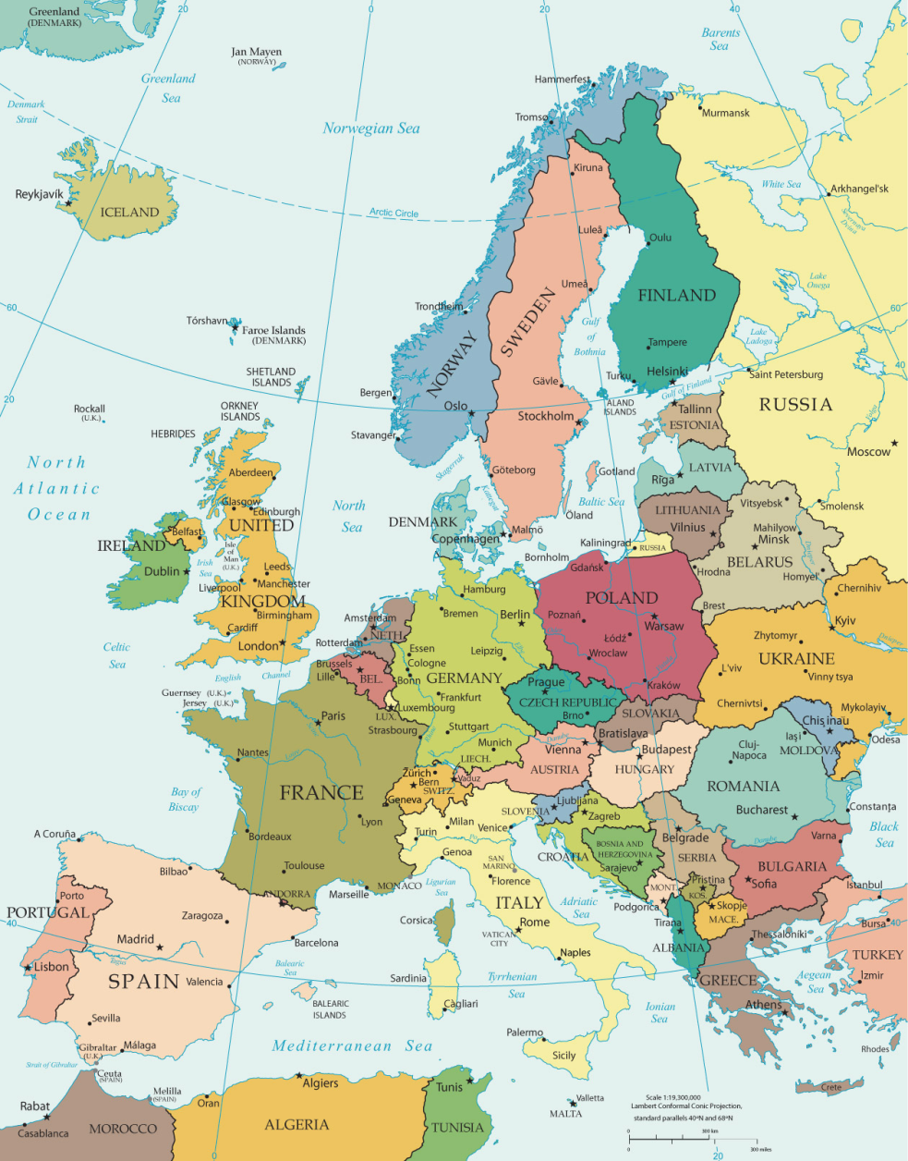
Partner countries:
ROMANIA
PORTUGAL
LITHUANIA
GREECE
BULGARIA
ROMANIA

Slide 3
Partner institutions:
SCOALA GIMNAZIALA NR. 10 SUCEAVA, ROMANIA
AGRUPAMENTO DE ESCOLAS BOA ÁGUA,
SESIMBRA, PORTUGAL
JUODSILIU SILO GIMNAZIJA, VILNIUS, LITHUANIA
GYMNASIO IOLKOU, VOLOS, GREECE
SU KONSTANTIN KONSTANTINOV, SLIVEN, BULGARIA
SCOALA GIMNAZIALA OSTRA, ROMANIA

Slide 4
Steam by steam:
STEAM is a curriculum based on the idea of educating students in five specific disciplines — science, technology, engineering art and mathematics — in an interdisciplinary and applied approach. Rather than teach the five disciplines as separate and discrete subjects, STEAM integrates them into a cohesive learning paradigm based on real-world applications, this way it stimulates pupils’ learning motivation. Pupils’ participation in active learning can strengthen relationships within the school, improve the classroom climate, accommodate a variety of learning styles and provide alternative ways of learning.
What does STEAM mean?

Slide 5
Steam by steam:
to increase pupils’ motivation to learn and their school results in the partner schools, using STEAM as a way to develop essential skills, such as: pro-active attitude, problem solving abilities, creativity, multitasking, initiative, anticipative capacity, teamwork, empathy, through exchanging experiences and good practices.
The project aim:

Slide 6
Steam by steam:
develop teachers’ skills to plan and do lessons in a STEAM vision, through a training course on this topic
O1
applying the STEAM approach, by the teachers, in lessons designed by themselves and by the partners
O2
The project objectives:
create the framework of developing essential skills for pupils, using STEAM as a pathway, through lessons delivered in the schools by teachers from the partner schools
O3
O4
develop a collection of ready-to-use STEAM professional development materials for teachers (lesson plans, games), uploaded on an on-line platform.

Slide 7
Steam by steam:
The project is a way to apply some teaching/learning methods from a country to another, adapting them accordingly. It becomes a way to experience teaching methods with different pupils, school environments, teaching materials, also a framework to develop pupils’ essential life skills using partner schools’ lesson ideas.
Target group: pupils 6-14 years old, primary & elementary teachers from partner schools, parents.
Additional: teachers’ training centers, NGOs.

Slide 8
Steam by steam:
The nowadays researches among the partner institutions of this project emphasize that the curriculum in their education system contains separate school subjects, such as Maths, History, languages, Technology a.s.o, delivered in specific and clearly defined classes, by teachers of these disciplines, sometimes not having a balance between them.
On the other hand, some of the schools, among them the Bulgarian, Greek and Romanian ones, teach such subjects in a too theoretical way, sometimes with no relationship with the real life.
Teachers should be that support for pupils, which conducts them to their own learning process.
For this reason, by the end of the project, the following results are expected:

Slide 9
Steam by steam:
pupils:
- 40% kids from the partner schools become more motivated in learning, and this will be visible in their results, both in school and extracurricular activities.
- 40% of them learn problem-solving skills to become better thinkers, within STEAM lessons.
This makes them more prepared for job markets after graduation.

Slide 10
Steam by steam:
b) teachers:
- 40% teachers from partner schools created STEAM lessons in an integrated vision, due to the exchanging experiences during the project transnational activities and uploaded them into the on-line platform, to be visible and useful for other teachers
- teachers participating into the transnational activities have developed communication skills in English and teaching skills to deliver STEAM lessons in the partner schools

Slide 11
Steam by steam:
c) partner schools:
- learn how to adapt and arrange the school schedule, in order to offer the pupils creative, interactive learning activities, able to develop them essential skills, among which creativity, self-confidence, multitasking, problem solving, critical thinking, also collaborative learning, tolerance to frustration and teamwork.
- school curricula focused on pupils’ complex and complete development

Slide 12
Steam by steam:
The tasks and responsibilities will be distributed among the partners as following:
From the very beginning of the project, each school will choose one of the following life skills, to specifically focus on, within the STEAM lessons/activities they will develop within the project:
1. learning to learn
2. decision making
3. problem solving
4. communication skills
5. critical thinking
6. leadership skills

Slide 13
Steam by steam:
In each school, they will work individually on the chosen life skill, and organize STEAM learning activities, within the school curricula, emphasizing ways to increase it, then, will permanently exchange information with the partners. They will design educational contexts to develop the chosen skill that can be transferred to the partner schools (examples of games, team-building activities, teaching methods, STEAM lessons).
Each of them will select at least two teachers who can teach at least four lessons/activities in the partner schools using STEAM approach designed for their own school, and experimented in the partner ones.

Slide 14
Steam by steam:
Among the partners, the tasks are the following:
RO Suceava: coordinate the project, manage all the communication among the partners; create the project website, organize the training course for teachers for STEAM approach - design the training kit; upload information on School Education Gateway and the Erasmus+ Project Results Platform, deal with any problem that could affect the project, design the intermediate and final report, support the schools with less/no experience in European projects. It will also monitor the project activities, create the framework for a very good communication and collaboration among the partners, avoiding any type of risks that can occur within the project. It will act as a mediator, facilitator, counselor, if necessary.

Slide 15
Steam by steam:
Portugal: organize the pupils’ exchange in Quinta do Conde, manage the arrangements for the accommodation of the pupils and teachers there, create the framework of teaching/learning activities within the host school, disseminate the project on the eTwinning platform, organize Edulab and STEAM lessons for the partner schools, using collaborative learning, create the framework for the participant teachers to teach in the host school, emphasizing how the chosen life skill (learning to learn; social development; decision making and problem solving; communication skills and critical thinking; leadership skills) deals with the taught content.

Slide 16
Steam by steam:
Greece: organize the pupils’ exchange in Volos, manage the arrangements for the accommodation of the pupils and teachers there, create the framework of teaching/learning activities within the host school, create and manage communication tools – e-group WhatsApp and Facebook.
Bulgaria: organize the pupils’ exchange in Sliven, manage the arrangements for the accommodation of the pupils and teachers there, create the framework of teaching/learning activities within the host school, manage communication tools, among them, Skype platform, where teachers and pupils will “meet” on-line and share teaching/learning experiences.

Slide 17
Steam by steam:
RO Ostra: organize the pupils’ exchange in Ostra, manage the arrangements for the accommodation of the pupils and teachers there, create the framework of teaching/learning activities within the host school, create and manage the evaluation and monitoring tools, create and manage the project online platform which will host STEAM models of activities to be used by other schools.
Lithuania: organize the pupils’ exchange in Vilnius, manage the arrangements for the accommodation of the pupils and teachers there, organize an workshop with the participating teachers in which to explain/train how to implement STEAM approach into lessons, others than science, technology, art and maths, create the framework of teaching/learning activities within the host school, provide a trainer for the teachers' training in Suceava.

Slide 18
Steam by steam:
Apart from this, every partner will:
- create informational portfolios about their town/village, school, education system, to be shared on the communication tools
- coordinate all the arrangements for the partnership activities in his school, prepare all the needed documentation
- translate the STEAM lessons shared by the partners into his language
- offer support for the partners related to accommodation, transport, arrangements for pupils
participant into the schools’ activities
- create the framework for intercultural exchanges, during the transnational activities in their
country/school The communication will be done using Facebook, e-group, website, also directly, through mobile devices (Whats App, Messenger, Instagram).

Slide 19
Steam by steam:
The involvement of associated partners
(page 49 aplication form):
Among the local partners in Romania, Asociatia Regionala pentru Educatie si Dezvoltare, which is an NGO focused on adult education, will be involved, dealing with support and logistics for the local activities and being also the link with the local community. It will be involved in the project activities and will help in providing professional translation for the documents of the project that need to be translates into Romanian, or in English.
The partner school from Portugal has a very close collaboration with CREF - Educational Resources and Training Centre from Sesimbra, whose director, Mr. Vitor Costa, European trainer within Erasmus+ KA1 program can offer his institution's expertize in implementing activities for fulfilling the project aims. CREF help will be materialized in workshops focused on mobile devices in education and how can STEAM be an alternative.
The partner school from Lithuania will benefit of the support of Education development centre, in which, Mrs. Egle Vaivadiene, methodist of Nature, Science and Technology Section will get involved during the activities developed in Vilnius, mainly in coordinating STEAM projects in school, during the transnational activity there.

Slide 20
Steam by steam:
How we will select and involve participants in the different activities (pag. 50, application form):
There will be a selection procedure. There are some suggestions, but each school can consider its own criteria.
Four teachers in each school, participants into the training course in Suceava, Romania, will be selected according to their level of English, which has to be at least B1. After the course, they will use the acquired information in their school activities, with their colleagues and pupils.
For the transnational activities, mostly pupils between 10-13 years old will get involved. Each
school will design their selection according to school policies.

Slide 21
Steam by steam:
Participants with fewer opportunities: does your project involve participants facing situations that make their participation more difficult? (pag. 51)
How many participants would fall into this category? 150
Which types of situations are these participants facing?
cultural differences
economic obstacles
educational difficulties
social obstacles
disability
health problems

Slide 22
Steam by steam:
Participants with fewer opportunities: does your project involve participants facing situations that make their participation more difficult? (pag. 51)
The participants with fewer opportunities who will be involved into the project activities are: 58 pupils
from School no 10 Suceava, Romania, 36 from School Ostra, Romania, 12 from the Bulgarian school, 15 from the Portuguese school, 11 from the Greek school, 18 from the Lithuanian school.
They will be involved both in the local activities and into the pupils’ exchanges.
They will be supported both by their colleagues and by their teachers to overcome these difficulties.

Slide 23
Steam by steam:
Please provide detailed information about the project activities that you will carry out with the support
of the grant requested under the item 'Project Management and Implementation‘ (page 55).
1. promotion of the project: each partner school will promote the project within its local community. A
common leaflet containing information about the project will be designed within the first project meeting, in English. Each partner will translate it in its own language and distribute it within the school area and community by the end of October 2019.

Slide 24
Steam by steam:
2. promotion: each school will design and create a roll-up or banner with basic information about the project: title, identifying number, partners, aim, objectives, main activities, by the end of November.
Also each partner school will design an "Erasmus+ corner" in the school building, visible for everybody, where there will be offered information about each step of the project.
3. small scale project materials, to be used within STEAM lessons in each partner school
4. local project activities, including documentation and research visits for pupils, participating into contests/ competitions within the project activities, organizing exhibitions with objects created by the pupils.

Slide 25
Steam by steam:
5. participating into seminars and/or meetings organized by the NA in each partner country, to inform
the partners about specific aspects related to the project management
6. dissemination and other similar activities not covered by other types of funding: professional meetings, round tables in other locations than the partner schools, in case that this requires rented space or materials
7. subcontracted services, such as printing documents in typography, or creating visual materials for the project purposes.

Slide 26
Steam by steam:
8. supporting bank transfers differences between the currency if necessary
9. payments for professional translation of the project materials: training kit for teachers, models of
"ready-to-use" STEAM materials
10. payment for the hosting on-line platform, if required
11. payment for specialists involved in the

Slide 27
Steam by steam:
Transnational project meetings (page 56):
There will be only one project meeting, the first one, called "TEAM in STEAM", in Quinta do Conde, Portugal, aiming to know the partner representatives.
They will also focus on the evaluation system, interactive
teaching/learning methods. The participants will be also involved into the hosting school's management, participating into lessons which will show both Edulab and STEAM approaches in the Portuguese school.
They will agree on some specific methodological aspects of using STEAM in developing essential skills for pupils.

Slide 28
Steam by steam:
Project meetings (page 56):
The other project meetings will be virtual ones, on Skype and on eTwinning space. The partners will agree on at least one virtual project meeting after each transnational learning/teaching/training activity, in order to report the way the activities were implemented, how did they work, what was the impact on the participants and what were the challenges they faced with. This way, they will be
minimum five virtual project meetings among the project coordinators and schools' headteachers.

Slide 29
Steam by steam:
How will the monitoring of the project activities be carried out and by whom? (page 58)
The following aspects will be monitored:
a) the way the allocated resources and the services offered fulfilled the targets.
The project coordinator will design a Google docs, with some sheets, in which each partner school will insert the way it used the allocated budget, specifically that one dealing with transnational activities.
b) the balance between the developed activities and the aims of the project
A Gantt chart will be designed within the project, and all the partners will have it and adapt the project activities following that chart.

Slide 30
Steam by steam:
How will the monitoring of the project activities be carried out and by whom?
c) the visibility of the project within the schools and the local area
Each school will have the project portfolio, with lists of activities, project team, responsibilities, also examples of activities developed at the school level. The “Erasmus+ corner” in which school will be also a monitoring instrument.
d) the impact it has for the target group, the school, its teachers, pupils’ families
This will be seen within the professional meetings, meetings with parents, in each school – that will have a written minute for each developed activity.

Slide 31
Steam by steam:
How will the monitoring of the project activities be carried out and by whom?
e) the added value the project brought into the school life
This will be, firstly seen in the pupils’ school results, then, in their behavior. Every three months a report will be completed, in which, a percentage (30%) of the pupils from the target group will be monitored, in terms of learning motivation, behavior, school results, comparing them with the same number of pupils who were not in the target group.
f) its sustainability within the school and its local community after the end of the project
The “ready-to-use” materials created at the partnership level will start to be used in the partner schools from the second year of the project.

Slide 32
Steam by steam:
Specific monitoring instruments will be:
- database with the target group pupils, an individual chart for each of them, in terms of school results and learning motivation
- lists with pupils and teachers participating into each project activity
- periodical exhibition (at least two per year) with things and artefacts created within STEAM lessons
- Google docs with lists of activities developed within the project
- project documents (decisions, allocated tasks for each member in the project team, budget documents, invoices, certificates of participation, additional documents – photos, videos – individual reports)
- monitoring documents required by educational authorities and/or NA
- Google docs progress questionnaires, with charts and diagrams emphasizing project steps done,participation, relevance for the school.

Slide 33
Steam by steam:
How will you assess the success of your project? (page 60)
The following aspects will be assessed:
the process – how the partners fulfilled their allocated tasks
results
budget
impact for the target group
Please, see the descriptors for each of the above mentioned items.

Slide 34
Steam by steam:
Assessing instruments (page 61):
- diplomas offered to pupils within a contest between the partner schools, called “Super STEAM”,
dealing with creating different artifacts and uploading the photos in the e-group
- recognition of the most involved teachers in the activities, at the partnership’s level
- evaluation forms after each transnational activity, including the training course in Romania
- assessment certificates and Europass Mobility for the participants to the training course in RO
- evaluation forms for local activities
- scoring grid for the STEAM lessons – 1 to 10 points for design.

Slide 35
Steam by steam activities:
1
2
3
4
5
STEAM as an
approach for
developing
essential
life skills – training
course
“Applying STEAM, developing learning motivation” - pupils’
exchange
“STEAM lessons and activities” – pupils’
exchange
“Learning life skills through STEAM” – pupils’
exchange
“Life skills, STEAM approaches” - pupils’
exchange
Suceava, RO
Vilnius, LT
Volos, GR
Sliven, BG
Ostra, RO

Slide 36
Steam by steam:
Erasmus+ corner in each school
pupils’p
ortfolios
common leaflet
STEAM lessons
Project products:
European
conference
learning
platform
training
kit
set of
STEAM
model
lessons
project’s
website

Slide 37







Steam by steam:

